Slide 1
Software Defined
Networking
(SDN)

Slide 2
A03-Gaurav Ahuja A05-Aamir Balawala A10-Aayush Bhatt A17-Ajay Chaudhary A62-Dev Nehate
By:-

Slide 3
Index
Traditional Network
Software Defined Network (SDN)
Data plane and Control plane
SDN Architecture
SDN Controller
Open Flow Protocol
Traditional vs SDN
SDN Benefits
Risk of SDN
References

Slide 4
Traditional network
Traditional network refers to the old conventional way of networking which uses fixed and dedicated hardware devices such as routers and switches to control network traffic.
The control plane and data plane are integrated in this network.
It is hardware-based.

Slide 5
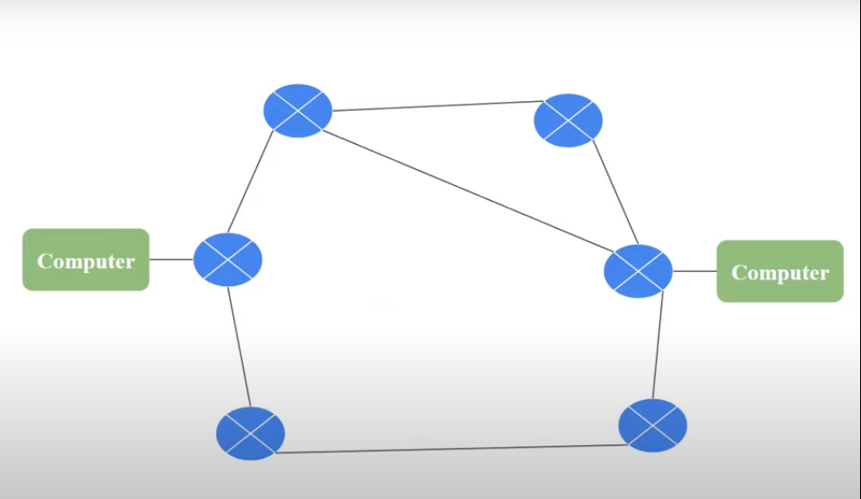
Traditional network

Slide 6
Software Defined Network(SDN)
Software-Defined Networking (SDN) is a network architecture approach that enables the network to be intelligently and centrally controlled, or 'programmed,' using software applications.
This model differs from that of traditional networks, which use dedicated hardware devices (i.e., routers and switches) to control network traffic.
SDN can create and control a virtual network or control a traditional hardware , via software.

Slide 7
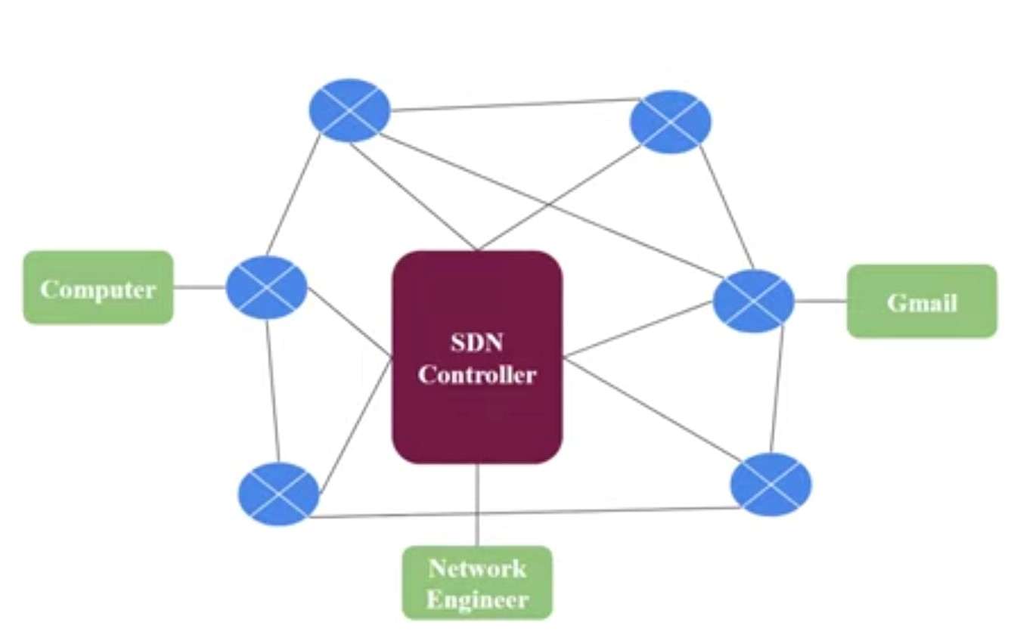
Software Defined Network(SDN)

Slide 8
How does SDN work?
SDN encompasses several types of technologies, including functional separation, network virtualization and automation through programmability.
In a SDN scenario, a packet arrives at a network switch. Rules built into the switch's proprietary firmware tell the switch where to forward the packet.
These packet-handling rules are sent to the switch from the centralized controller.
The switch sends every packet going to the same destination along the same path and treats all the packets the same way.

Slide 9
Data Plane
All the activities involving as well as resulting from data
packets sent by the end user belong to this plane.
This includes:
Forwarding of packets
Segmentation and reassembly of data
Replication of packets for multicasting

Slide 10
Control Plane
All activities necessary to perform data plane activities but do not involve end user data packets belong to this plane.
This is the brain of the network.
The activities of the control plane include:
Making routing tables
Setting packet handling policies

Slide 11
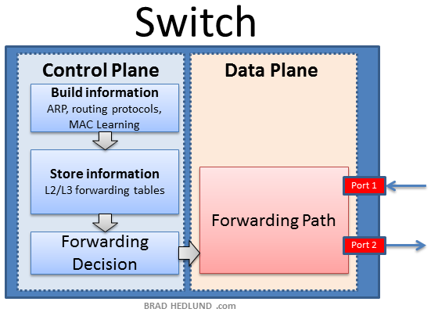
Data and Control Plane

Slide 12
SDN Architecture
A typical representation of SDN architecture comprises three layers: the application layer, the control layer and the infrastructure layer. These layers communicate using northbound and southbound application programming interfaces (API).
Application Layer
Control Layer
Infrastructure layer

Slide 13
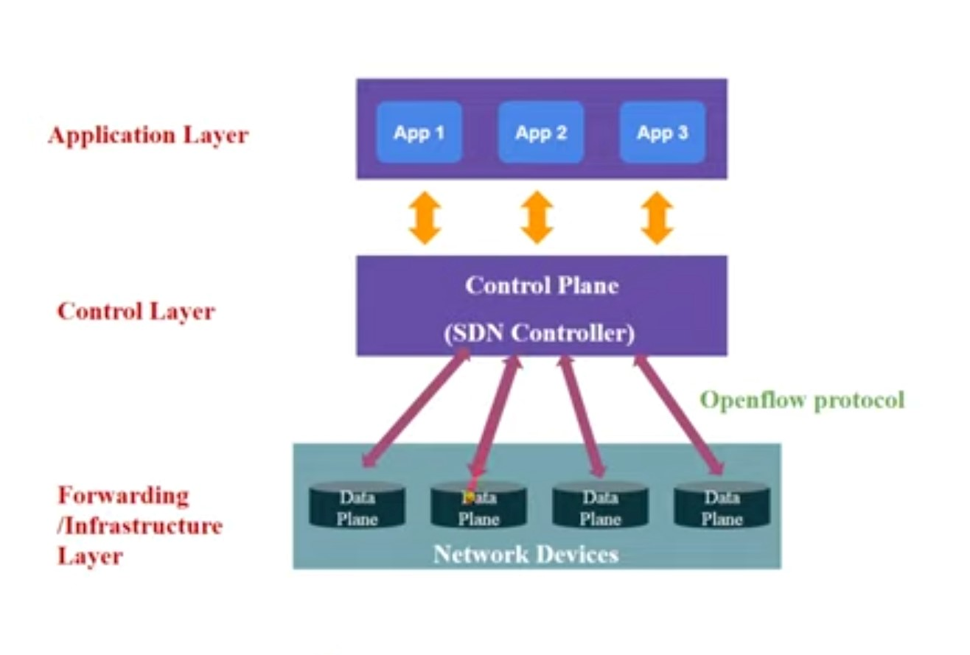
SDN Architecture

Slide 14
SDN Controller
All traditional networking devices like router and switches uses distributed control plane. But newer model of networking i.e., Software-defined Networking (SDN) uses centralized control plane.
Each device have their own control plane to control data plane. In Centralized control plane system, there is a device which contains control plane of all devices.
This device control the activities of data plane of all networking devices simultaneously. This device is called Controller or SDN controller.
The SDN controller platform typically runs on a server and uses protocols to tell switches where to send packets.

Slide 15
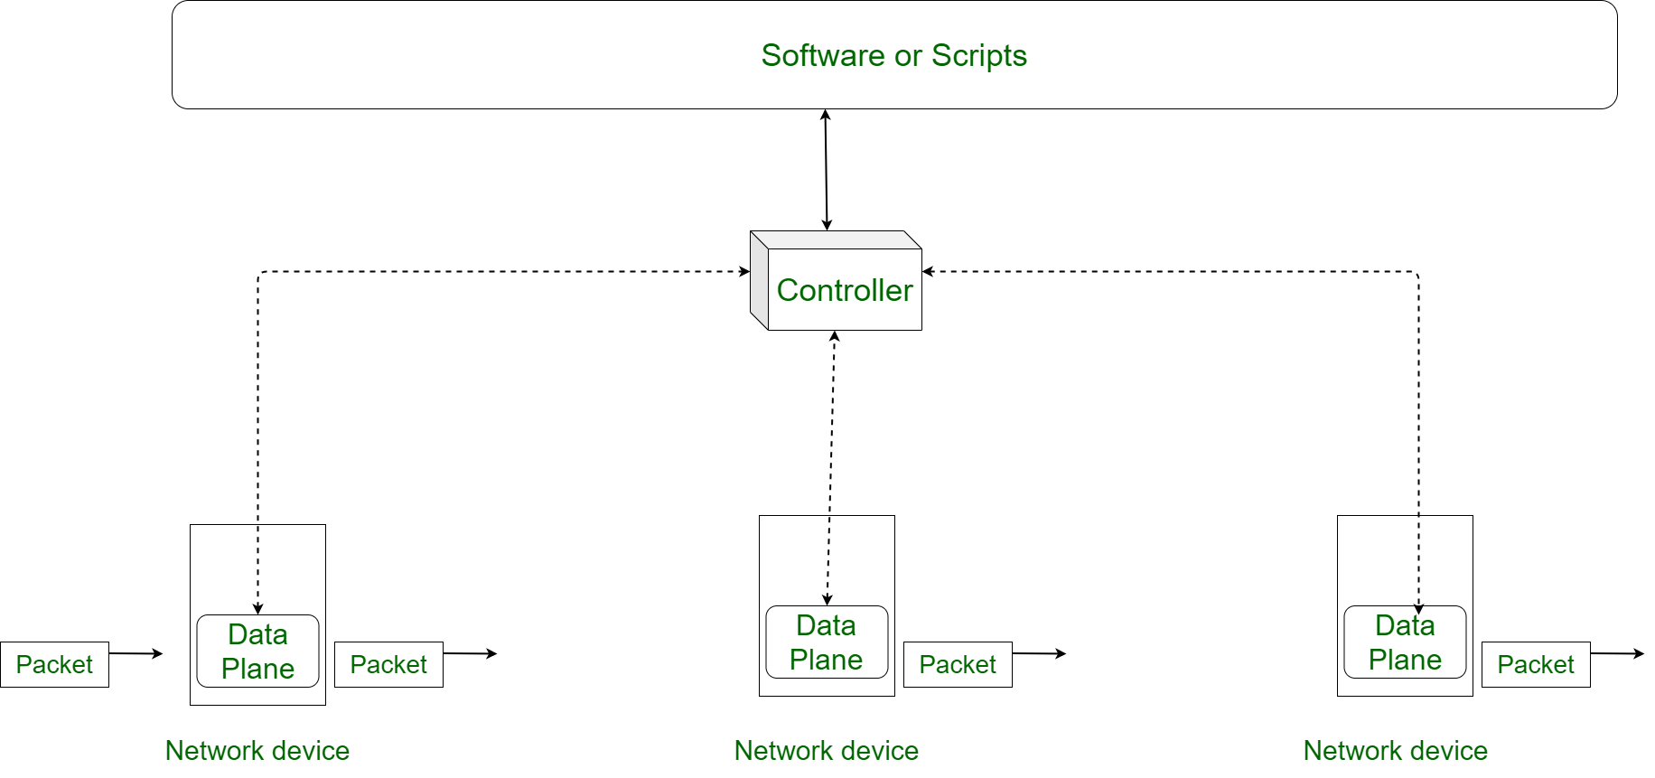
SDN Controller

Slide 16
Northbound and Southbound API
In software-defined networking, the southbound interface is the OpenFlow protocol specification, which allows communication between the SDN controller and the network nodes.
The northbound interface is protocol-supported communication between the controller and applications or higher-layer control programs.

Slide 17
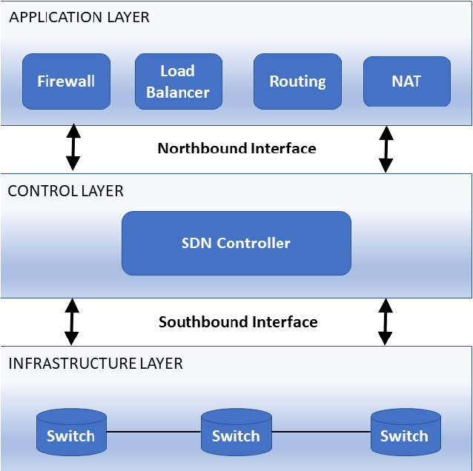
Northbound and Southbound API

Slide 18
Open Flow Protocol
Open Flow is the protocol that allows the SDN controllers to communicate with the forwarding plane of network devices.
It originally defined the communication protocol in SDN architectures that enabled the SDN controller to directly interact with the forwarding plane of network devices such as switches and routers

Slide 19
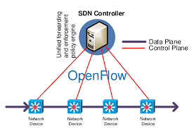
Open Flow Protocol

Slide 20
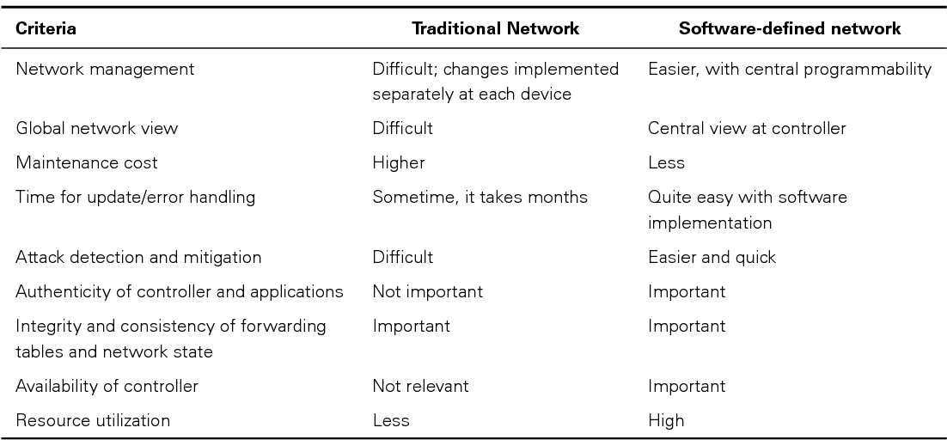
Traditional network VS SDN

Slide 21
SDN Providers
Cisco
VMware
Juniper Networks
IBM
Lumina
Colt Technology
Versa Networks
Junos Space

Slide 22
Benefits of SDN
Management
Programmable networks
Centralized managements
Agility
Visibility
Cost Efficiency
Security

Slide 23
The risks of SDN
SDN solutions come with significant benefits but can pose a risk if not implemented correctly. The controller is critical in maintaining a secure network. It is centralized and, therefore, a potential single point of failure.
The central dependency of the network means single point of failure, i.e. if the controller gets corrupted, the entire network will be affected.
This potential vulnerability can be mitigated by implementing controller redundancy on the network with automatic failover.
This may be costly but is no different from creating redundancy in other areas of the network to ensure business continuity.

Slide 24
References
https://www.vmware.com/topics/glossary/content/software-defined-networking.html
https://www.vmware.com/topics/glossary/content/software-defined-networking.html
https://www.techtarget.com/searchnetworking/definition/software-defined-networking-SDN
https://youtu.be/quuat3SHEMY
https://www.geeksforgeeks.org/software-defined-networking

Slide 25
Thank You

